Slide 1

BREAST CANCER PREDICTION
Made by:–
Saurabh , Utkarsha , Rutika

Slide 2
Introduction
In medical diagnosis, a disease's prediction is an important core in analyzing medical images.
The unwanted cell growth in any part of the organ is known as a tumor. The tumor may be benign or malignant.
A malignant tumor is the most dangerous tissue. So, the early diagnosis of the disease helps to prevent cancer.
In women, breast cancer is treated as the most significant issue. There are various researchers studied the prediction of breast cancer.
We are going to compare different models such as Random Forest, Gradient Boosting Machine (GBM), Light Gradient Boosting Machine (lightGBM) and XGBoost through PCA analysis and then after comparing these models using cross-validation decide the best model.

Slide 3
Data Summary
Dataset was found on Kaggle.com
The dataset used to predict Breast Cancer is taken from UCI Machine Learning Repository named Breast Cancer Wisconsin (Diagnostic) Data Set.
The dataset includes a set of 30 features that describe the properties of the cell nuclei visible in the digital image of a fine needle aspirate (FNA) of a breast tumor.

Slide 4




Features
Feature Name | Description | Data Type
id | ID number | numeric
diagnosis | The diagnosis of breast tissues (M = malignant, B = benign) | string, dual value
radius_mean | mean of distances from center to points on the perimeter | numeric
texture_mean | standard deviation of gray-scale values | numeric
perimeter_mean | mean size of the core tumor | numeric
Few features from the dataset.

Slide 5
Data Preparation Steps
Downloading of the dataset.
After downloading we saw some unwanted data which was not required for our analysis, so we updated the dataset.
We removed the id, diagnostic features, and the feature named X (populated with only NA values).
We move ahead by plotting features and some feature density plots.

Slide 6
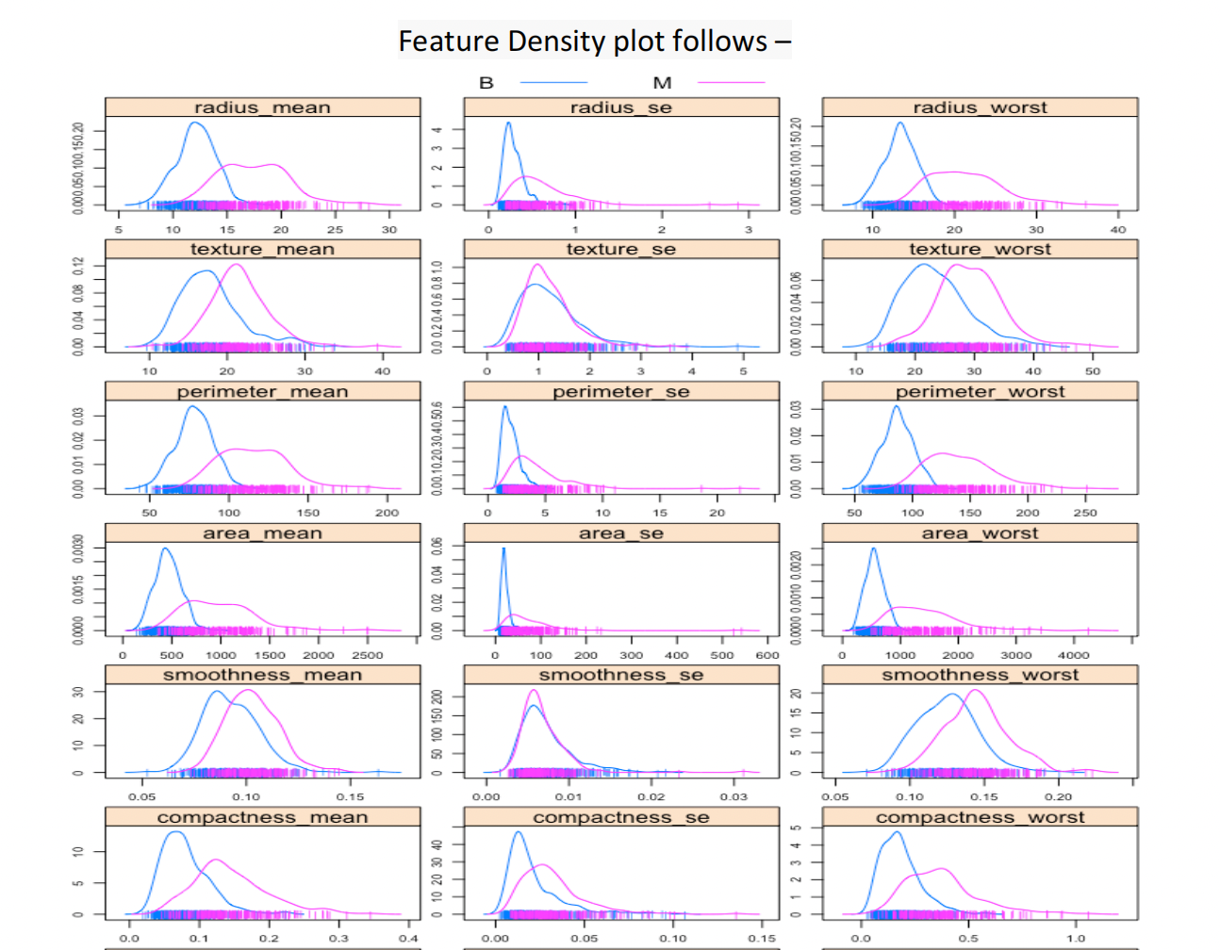
Feature Density Plot

Slide 7

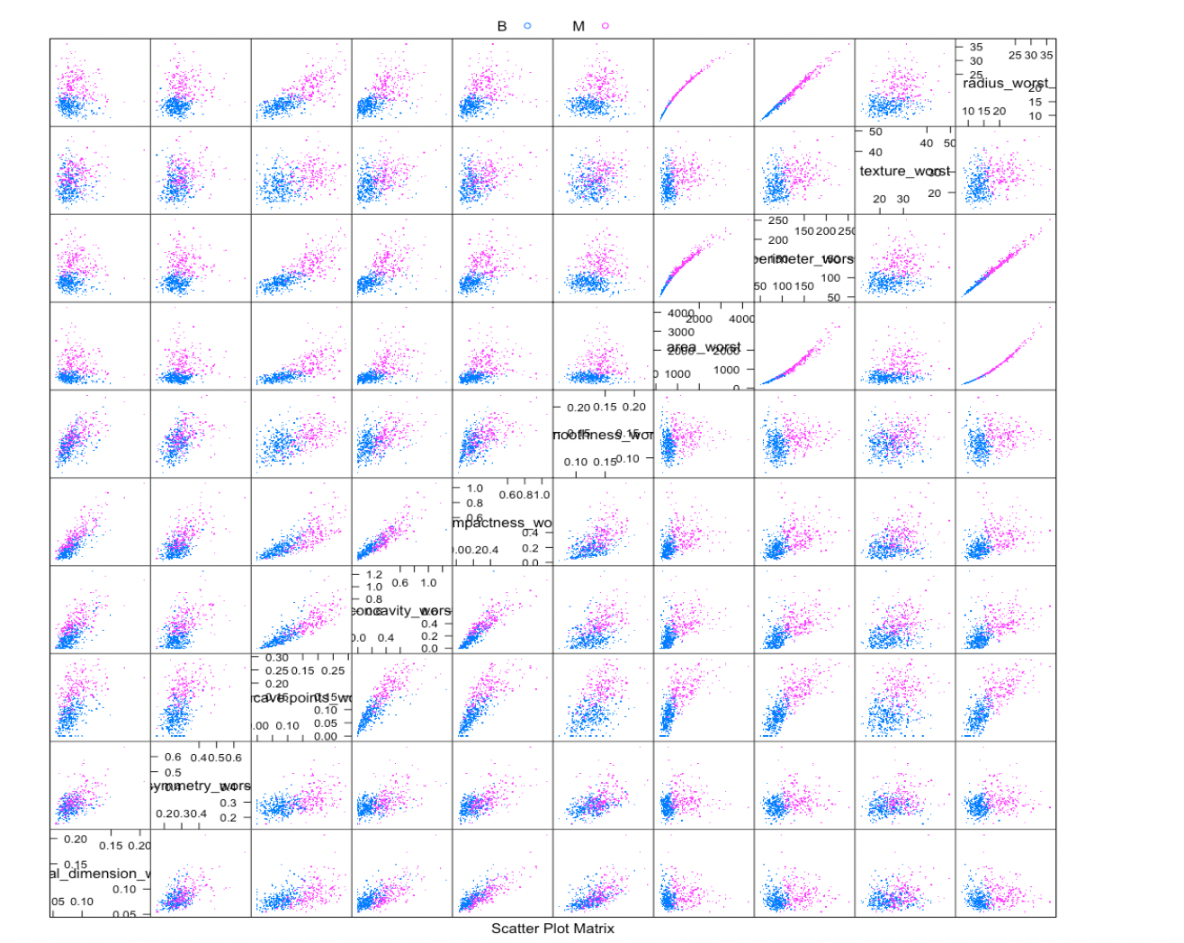
Feature Pairs

Slide 8
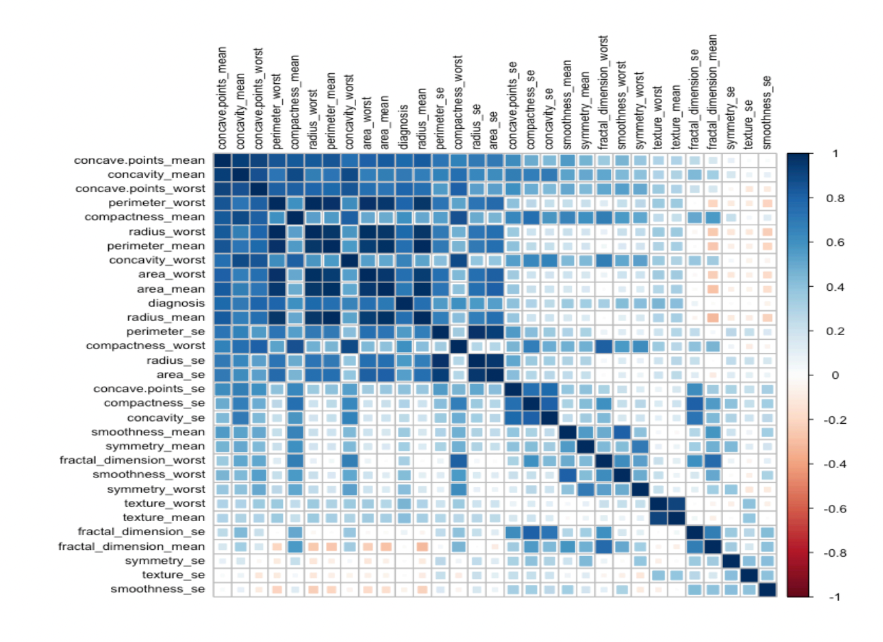
Correlation Matrix

Slide 9
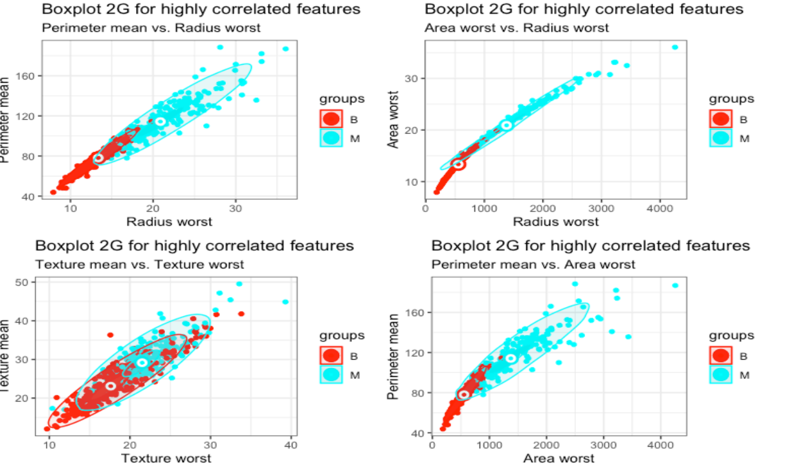
Highest Correlation Matrix
The highest correlations were seen between below parameters:
perimeter_mean and radius_worst
area_worst and radius_worst
perimeter_worst and radius_worst, perimeter_mean, area_worst
area_mean, radius_mean
texture_mean and texture_worst
Continued…

Slide 10
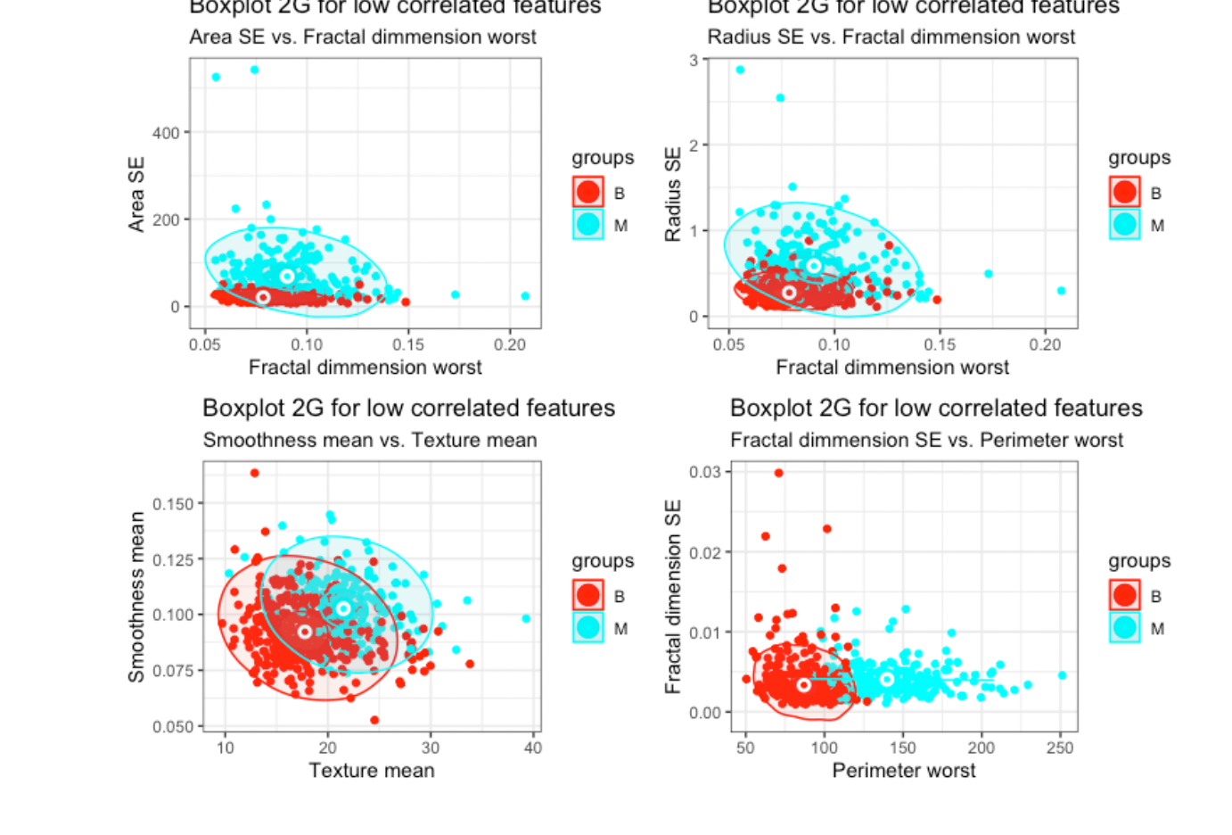
Lowest Correlation Matrix
Low-correlated features that have at the same time a considerable overlap for the two M and B groups
ex: fractal_dimension_worst and area_se
As well as low correlated features that have at the same time a good selectivity for M and B groups
ex: perimeter_worstand fractal_dimension_se
Continued…

Slide 11
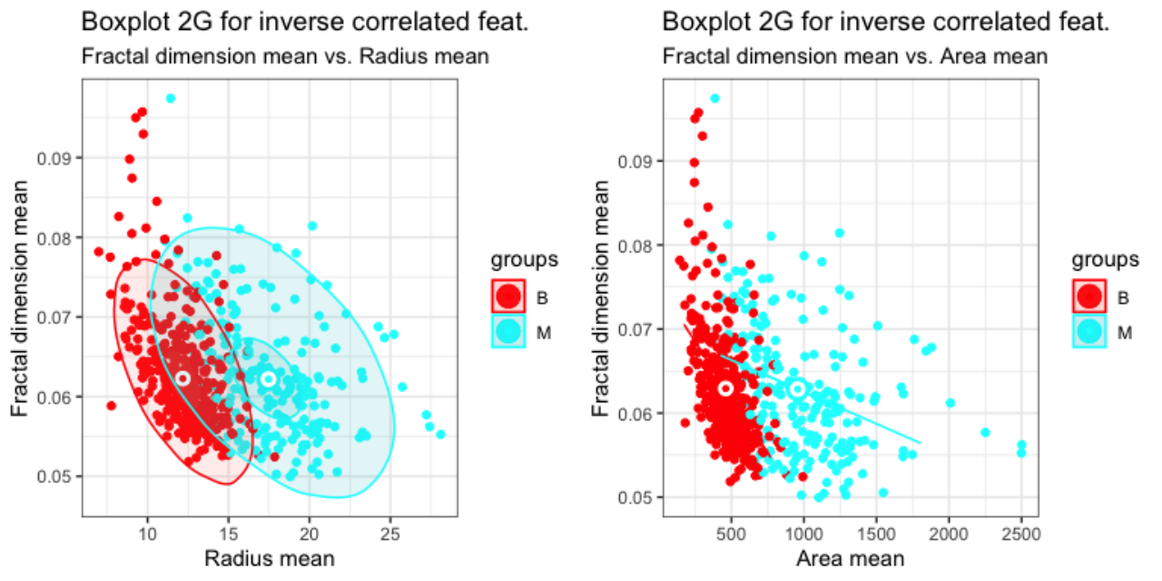
Inverse Correlation Matrix
Inverse correlated features through the same procedure
Fractal dimensions mean and Radius mean.
Fractal dimensions mean and Area mean
Continued…

Slide 12
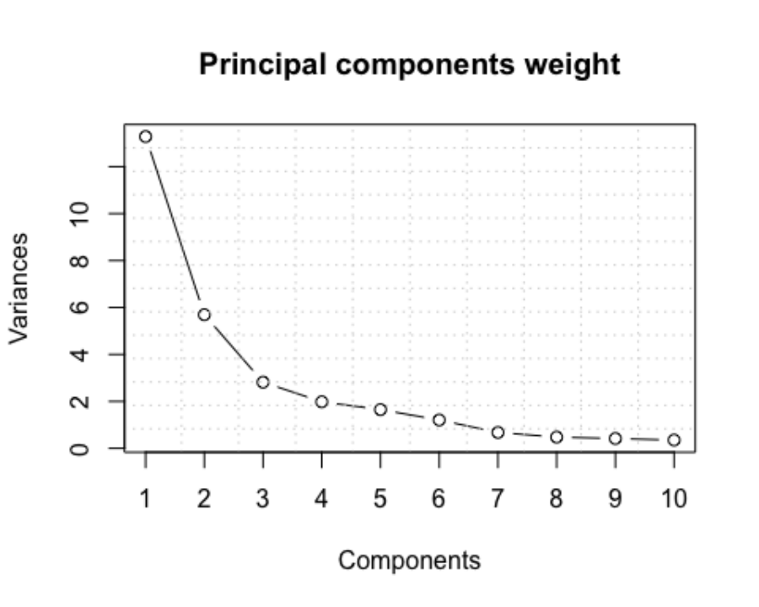
Principal Component Analysis (PCA)
A method of linear dimensionality reduction is PCA.
It preserves as much of the diversity in the original dataset as feasible.
While transforming a collection of correlated variables (p) into a smaller k (k < p) a number of uncorrelated variables are known as principal components.

Slide 13
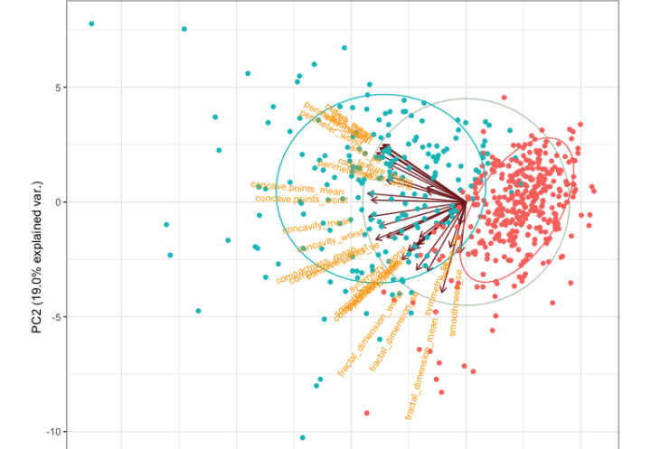
Principal Component Analysis (PCA)
A method of linear dimensionality reduction is PCA.
It preserves as much of the diversity in the original dataset as feasible.
While transforming a collection of correlated variables (p) into a smaller k (k < p) a number of uncorrelated variables are known as principal components.
The first two Principal Components are explaining together 63.3% of the variance.
Continued….

Slide 14
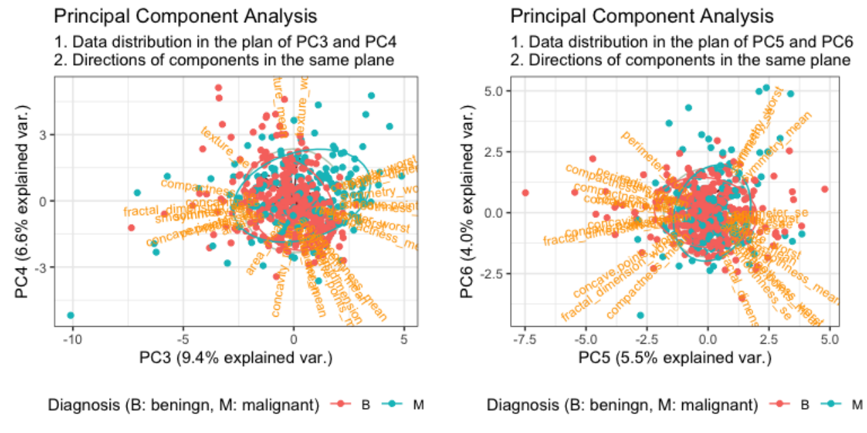
Principal Component Analysis (PCA)
Principal components PC3-PC6 are explaining together 25.5% variation.
We can observe that not only there is no significant alignment of a certain feature with one of the PC3:PC6 principal components
Also, in the planes {PC3, PC4} and {PC5, PC6} the B and M points are not separated in distinct clusters like is the case in the {PC1, PC2} plane.

Slide 15
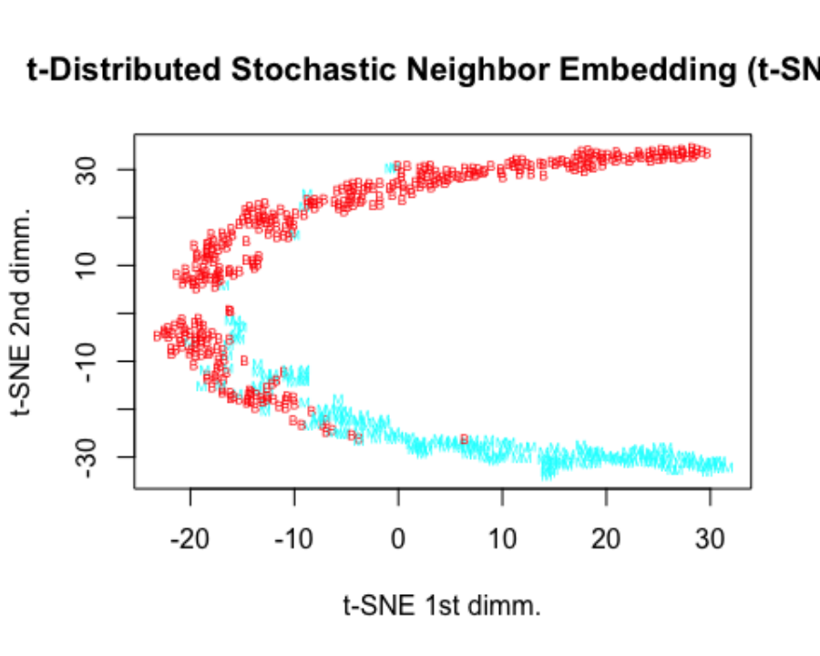
T-SNE Transform
t-SNE is a non-linear dimensionality reduction approach in contrast to PCA, which is a linear algorithm.
By detecting observable clusters based on the similarity of data points with various attributes, it uncovers patterns in the data.
At the same time, it is a dimension reduction algorithm that may be applied as a data exploration and visualization approach; it is not a clustering algorithm.
We can observe the separation of the data in the t-SNE 1st and 2nd dimension plan of the data point clouds for the two values of the target (M and B).

Slide 16
Modeling and Analysis
Random Forest
Gradient Boosting Machine
Light Gradient Boosting Machine
eXtreme Gradient Boost (XGBoost)
Weighted Average Values

Slide 17
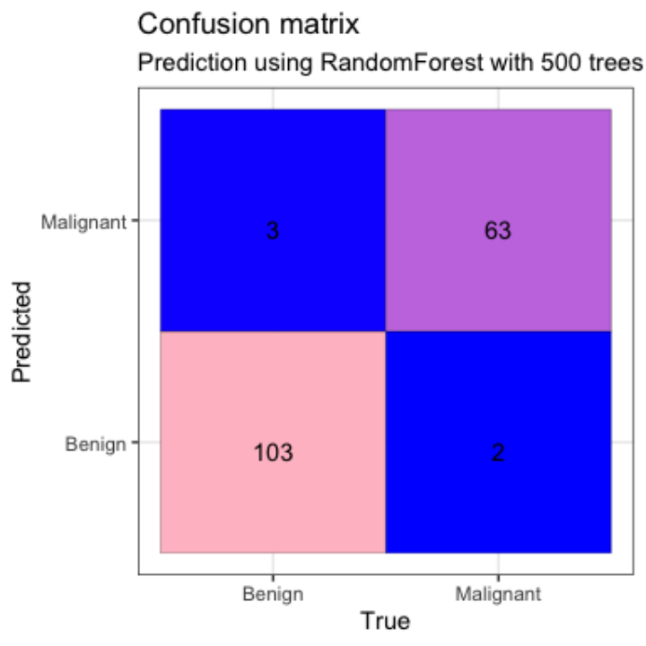
Random Forest (Observations)
The most significant features, according to our observations, are perimeter worst, area worst, and concave.points worst, radius worst, concavity mean, concavity worst, area se, and concave points mean.
Confusion Matrix for original features with 500 trees
The Area under cure (AUC) for Random Forest is 0.970.

Slide 18
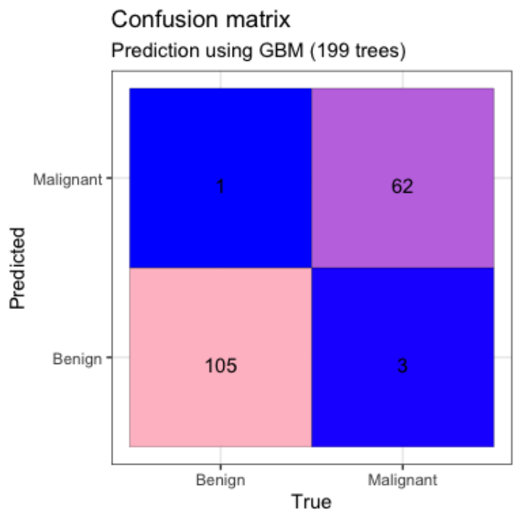
Confusion Matrix of GBM
The Area under cure (AUC) for Gradient Boosting Machine (GBM) is 0.972.
Gradient Boosting Machine (GBM) is one of the most popular forward-learning ensemble methods in machine learning.
It is a powerful technique for building predictive models for regression and classification tasks.
GBM constructs a forward stage-wise additive model by implementing gradient descent in function space.

Slide 19
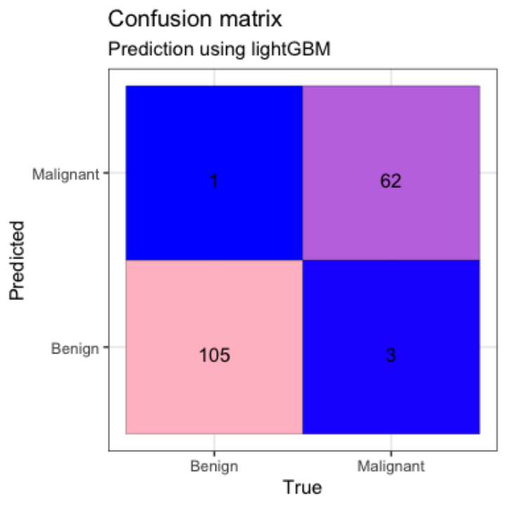
Confusion Matrix of LGBM
The Area under cure (AUC) for Light Gradient Boosting Machine (lightGBM) is 0.972.
LightGBM extends the gradient boosting algorithm by adding a type of automatic feature selection as well as focusing on boosting examples with larger gradients.
This can result in a dramatic speedup of training and improved predictive performance.
It is based on decision tree algorithms and used for ranking, classification and other machine learning tasks.

Slide 20
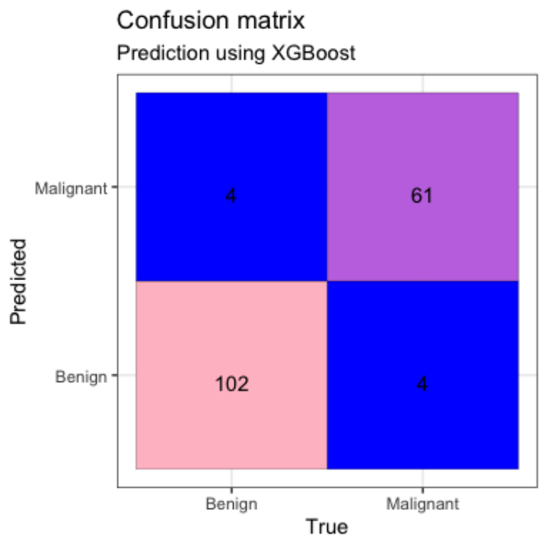
Confusion Matrix of XGBOOST
The Area under cure (AUC) of eXtreme Gradient Boost (XGBoost) is 0.950.
XGBoost is an implementation of Gradient Boosted decision trees.
Weights play an important role in XGBoost.
Weights are assigned to all the independent variables which are then fed into the decision
Tree which predicts results.
It can work on regression, classification, ranking, and user-defined prediction problems.

Slide 21
Conclusion
After performing exploratory analysis we found that few features provide a higher predictive value for the diagnosis, according to the feature analysis.
The PCA analysis supported the observations by demonstrating that the same features have greater dimensions or are aligned to the major principal component in the PCA plan.
Concave describes these traits- worst ponts, worst concavity mean, worst concavity, worst perimeter, and worst area.
Based on the four models we used—Random Forest, Gradient Boosting Machine (GBM), Light Gradient Boosting Machine (lightGBM), and XGBoost—we were able to accurately forecast the malignant and benign tumors.
Cross-validation was also used to determine the optimal model for the GBM, lightGBM, and XGBoost models.
Using the GBM model, posed the best prediction model.

Slide 22
Thank You

